Slide 1

Product Introduction of CRRC Datong's
Mining Dump Truck
May 2022
CRRC Datong Co., Ltd.

Slide 2
Content
I
Company Profile
R&D capabilities of Mining Dump Truck
II
III
Product Introduction of CRRC Datong
IV
Internal Supporting of Core Components
V
Technology under Development
VI
Advantages of CRRC’s Mine Dump Truck

Slide 3
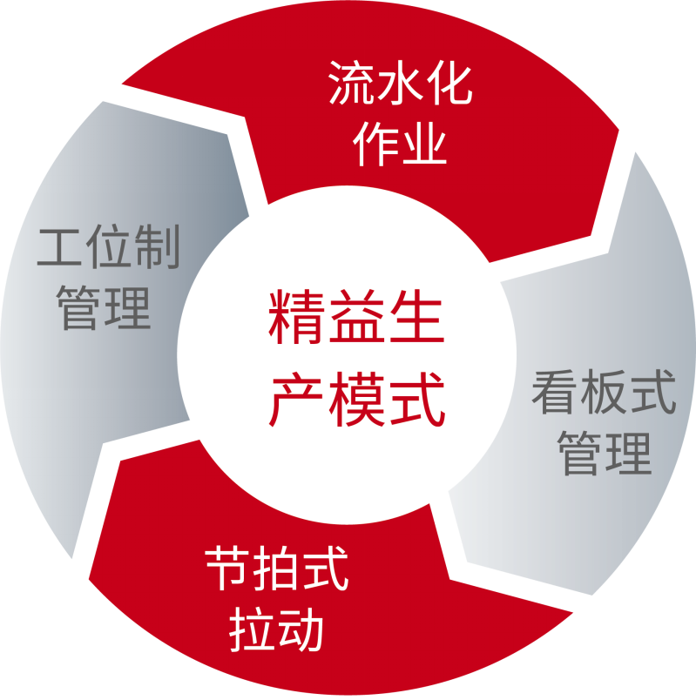
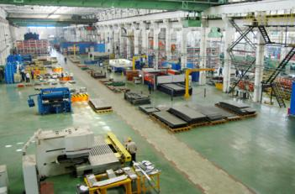
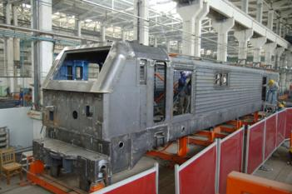
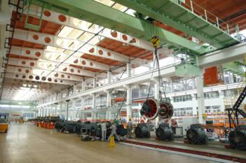
I | Company Profile
——CRRC Datong Introduction
CRRC Datong is a core subsidiary of CRRC Group, with a professional R&D team and strong R&D and production capabilities.
Streamlined operation
Work-
station manage-ment
lean production
2
Through two large-scale technological transformations, the company has comprehensively introduced, digested and absorbed world-class electric locomotive manufacturing processes.Through the in-depth promotion of lean production, the production efficiency and product quality have been greatly improved again.At present, the company's production system has a reasonable layout, smooth technological process, advanced equipment level, and equipment manufacturing capacity has reached the world's leading level.
Kanban manage-
ment
Beat pull

Slide 4
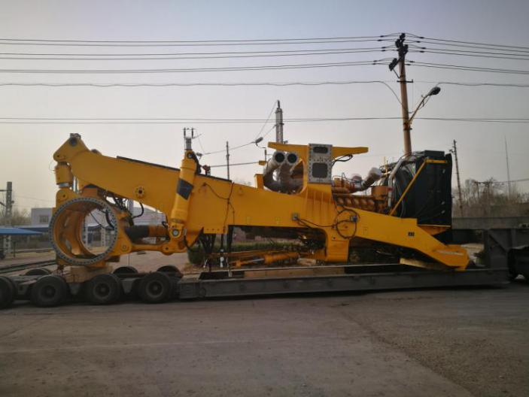
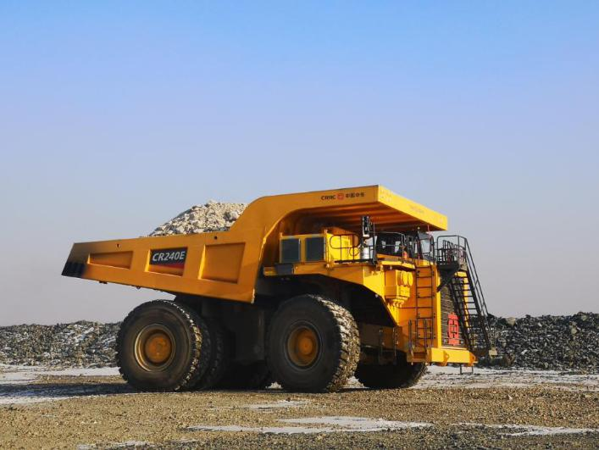
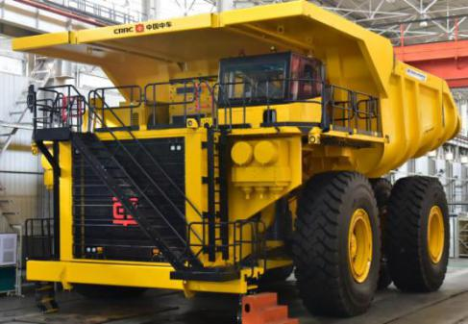
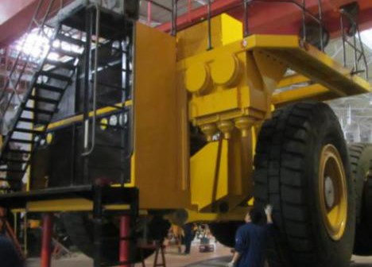
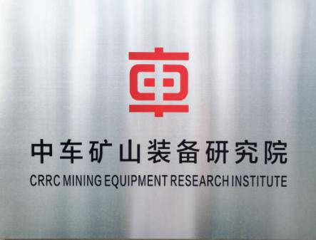
I | Company Profile
——CRRC Datong Introduction
CRRC Datong, as the leading company in the integration of complete machines and core technologies of CRRC mine trucks in CRRC, shoulders the important task of achieving advancement through production and breaking through the monopoly of foreign core technologies.
CRRC Datong has the world's leading mining truck R&D technology and concepts, and fully utilizes the overall advantages of CRRC Group in the equipment manufacturing industry, internal product supporting advantages, strong international sales network advantages and brand advantages.

Slide 5
Content
I
Company Profile
II
R&D Capabilities of Mining Dump Truck
III
Product Introduction of CRRC Datong
IV
Internal Supporting of Core Components
V
Technology under Development
VI
Advantages of CRRC’s Mine Dump Truck

Slide 6
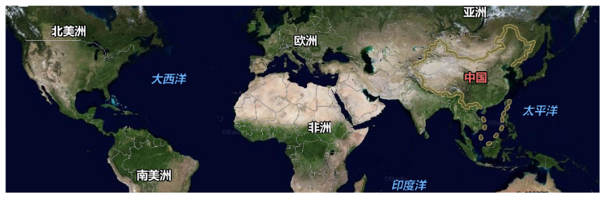
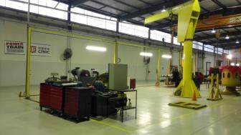

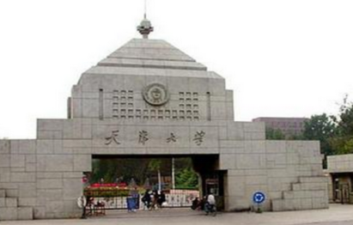
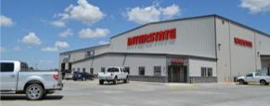

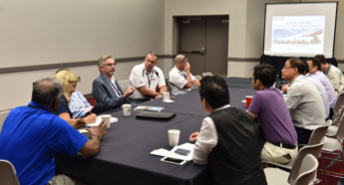



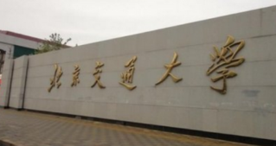
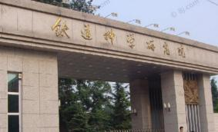
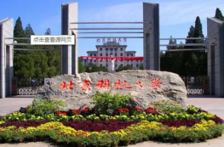
II | R&D Capabilities of Mining Dump Truck
——R&D Capabilities
Well-known strategic partners, build a world-class mining truck
Collaborative Design
02
Industry-University-Research
Cooperation
03
Customer orientation
01
It has established a long-term cooperative relationship with the world-renowned mining truck design company DHTE in the United States, has a world-class R&D platform, and is committed to building a world-class mining truck.
Established a postdoctoral workstation jointly with Tsinghua University, and established extensive cooperation with University of Science and Technology Beijing, Victoria University of Canada, Tianjin University, Beijing Institute of Technology, Southwest Jiaotong University, Beijing Jiaotong University, China Academy of Railway Sciences, etc.
Cooperate with well-known service companies (Power Train, Interstate, Smith Power) to achieve full-scale overseas services and prepare to enter the world.
Collaborative Design

Slide 7
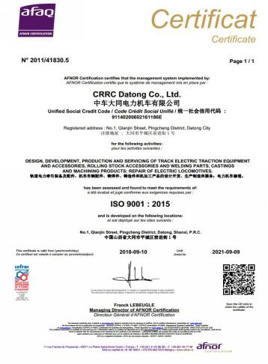
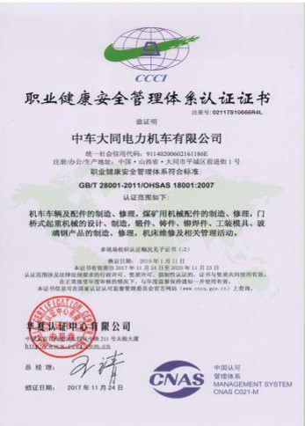
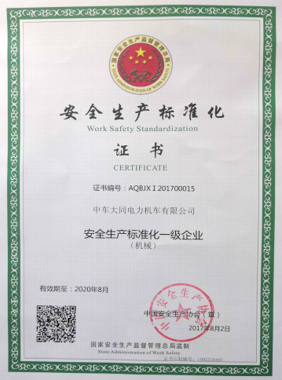
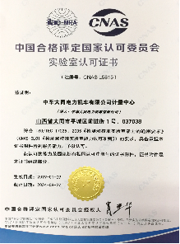
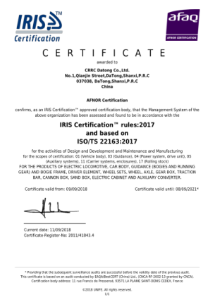
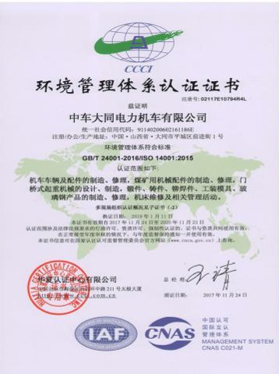
II | R&D Capabilities of Mining Dump Truck
——Manufacturing Capabilities
Strong manufacturing capability and strict process control
Establish a flexible production line for mining trucks, which is co-produced with railway rolling stock. From blanking, forming, welding, machining to product assembly line, we adopt mature manufacturing technology and strict process control.
The company has passed ISO9001, TS22163, IRIS, EN15085, ISO14001, OHSAS18001 certification.

Slide 8
Content
I
Company Profile
II
R&D Capabilities of Mining Dump Truck
III
Product Introduction of CRRC Datong
IV
Internal Supporting of Core Components
V
Technology under Development
VI
Advantages of CRRC’s Mine Dump Truck

Slide 9
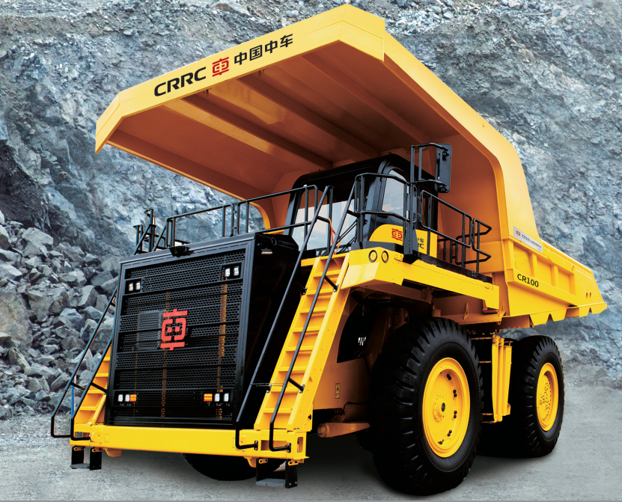
III | Product Introduction of CRRC Datong
——CR100M Introduction
1. CR100 Mechanical Transmission Mining Dump Truck
Dimensions 11142×5828×5651mm
Rated load 91000kg
Curb weight 74000kg
Maximum total mass 165000kg
Stacking capacity 60m³
Total power 1050hp
Top speed 55km/h
Diesel engine MTU16V2000C12
（Option: Cummins QST30）
Gearbox Alison H 8610A
Suspension Front Suspension/MacPherson
Rear suspension/four-link structure
Brake Wet brake + spring parking brake
Project situation
The first vehicle was tested in Zijinshan Gold and Copper Mine under Zijin Mining Group. It has been running for 1,944 hours with full load, with a running mileage of 12,416 kilometers and a transportation volume of 404,474 tons.

Slide 10
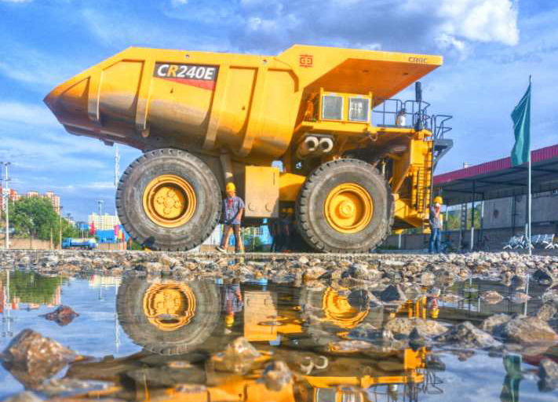
III | Product Introduction of CRRC Datong
——CR240E Introduction
2. CR240E Electric Driven Mining Dump Truck

Slide 11
III | Product Introduction of CRRC Datong
——CR240E Introduction
2. CR240E Electric Driven Mining Dump Truk
Dimensions 5288×8050×7100mm
Rated load 220000kg
Curb weight 172000kg
Maximum total mass 392000kg
Stacking capacity 160m³
Total power 2500hp
Tire 46/90R57
Top speed 57km/h
Converter system tPower-TC4
Diesel engine MTU16V4000C13L
（option: Cummins QSK60 ）
Generator YJ177E
Traction motor YP763-6
Suspension Front Suspension/MacPherson，
Rear suspension/four-link structure
Brake Wet brake + spring parking brake
Steering device Hydraulic assist automatic return
lift system Secondary lift hydraulic cylinder
Project situation
The first truck was assembled in May 2018 and passed the in-plant test, with a full-load running mileage of more than 1,500 kilometers, and completed the test and commissioning after installing the LNG-diesel dual-fuel system; the second CR240E mining car was launched in June 27th, 2019 and sent to Qidashan Mine, a subsidiary of Ansteel Group Mining Co., Ltd., for industrial testing on August 26th, 2019.

Slide 12
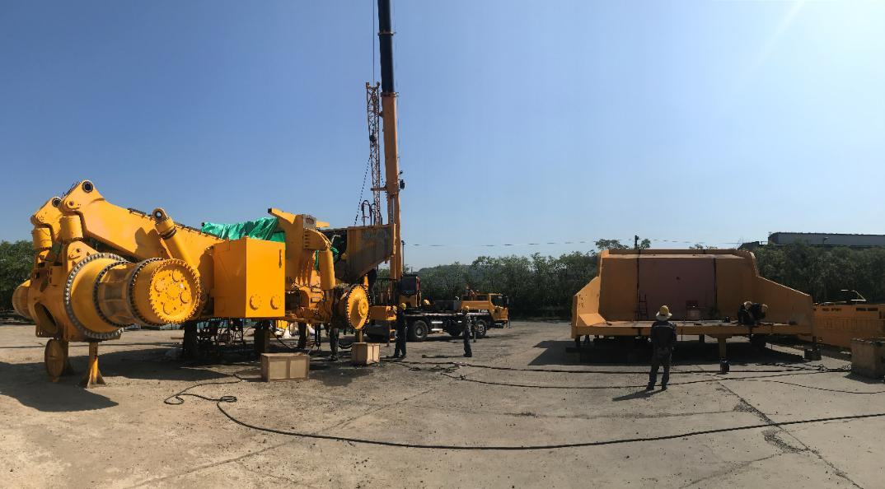
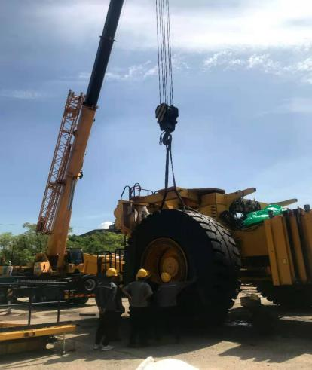
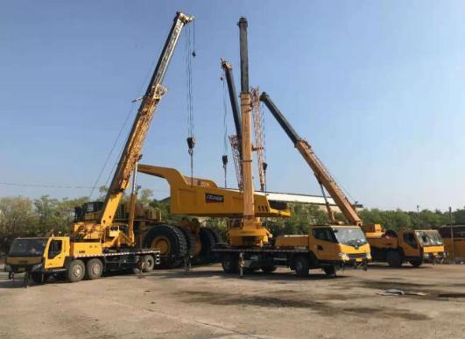
III | Product Introduction of CRRC Datong
——CR240E Introduction
General situation of industrial test for CR240E truck
On December 27, 2018, CRRC Datong and Qidashan Iron Mine of Ansteel Mining Group signed an industrial test agreement for CR240E mining dump truck. On June 27, 2019, the CR240E mining truck customized for Ansteel had launched at CRRC Datong. On August 26,2019, the CR240E mining trucks were all transported to the lower industrial site of the Qidashan Iron Mine in the form of large parts, and began to be assembled after the safety training.

Slide 13
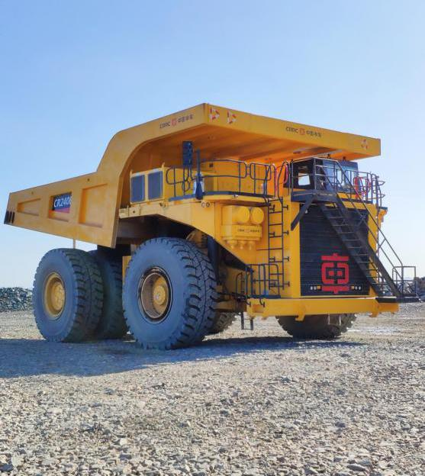
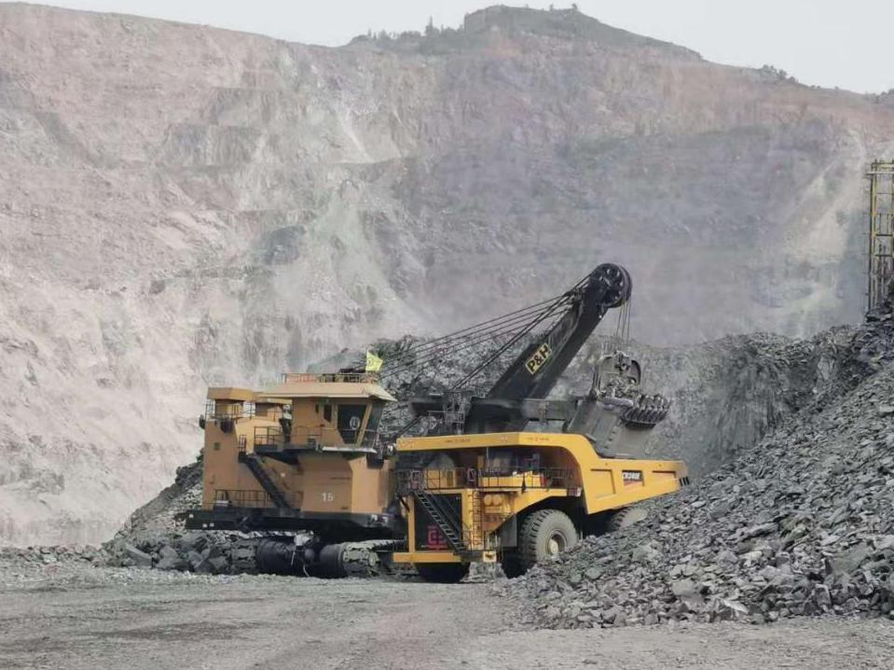
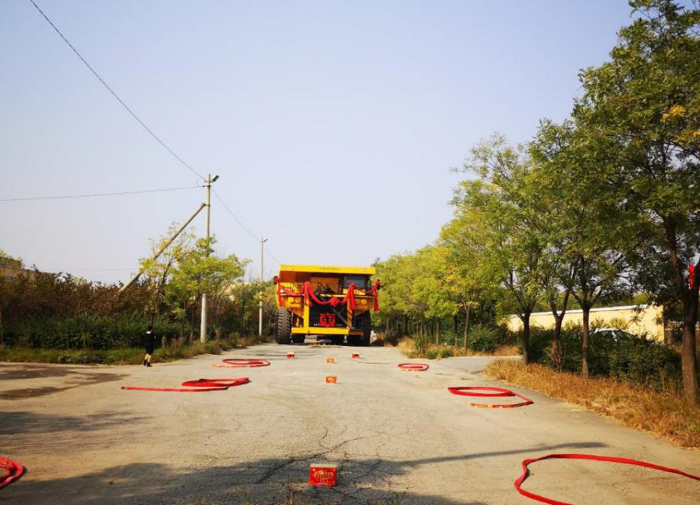
III | Product Introduction of CRRC Datong
——CR240E Introduction
On September 29, 2019, the CR240E mining truck was assembled, and on September 30, it successfully entered into the truck operation area of Qidashan Iron Mine, and began to carry out various static and dynamic commissioning work. On November 22, personnel from the relevant departments of Qidashan Iron Mine held a special meeting with the on-site person from CRRC Datong Company to officially deliver the CR240E mining truck to Qidashan Iron Mine and complete the grouping with other production vehicles in the truck operation area. . The CR240E mining truck started a one-year industrial trial.

Slide 14
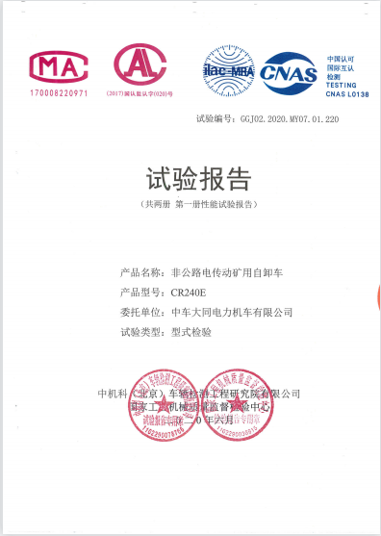
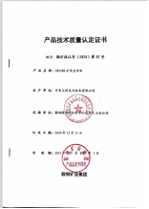
III | Product Introduction of CRRC Datong
——CR240E Introduction
During the test, CRRC Datong invited the third-party testing agency "National Construction Machinery Quality Supervision and Inspection Center" to test the performance, safety and reliability of the CR240E mining truck, and the test results were all within the qualified range.
On November 22, 2020, the one-year industrial trial ended successfully. On December 11, the CR240E electric drive mining truck successfully passed the final review of the industrial test performance certification of the product by Ansteel Group Mining Company, and obtained the product technical quality certification issued by Ansteel Group Mining Company. During the industrial test, the driving rate of the CR240E mining truck reached 98.84%, and the product performance and quality were highly appraised by users.

Slide 15
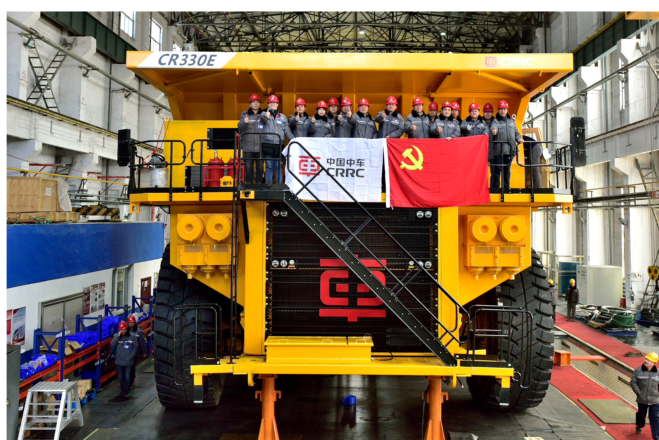
III | Product Introduction of CRRC Datong
——CR330E Introduction
3. CR330E Electric Driven Mining Dump Truck

Slide 16
III | Product Introduction of CRRC Datong
——CR330E Introduction
3. CR330E Electric Drive Mining Dump Truck
Dimensions 5600×8700×7400mm
Rated load 300000kg
Curb mass 216000kg
Maximum total mass 516000kg
Stacking capacity 218m³
Total power 3000hp
Tire 53/80R63
Top speed 58km/h
Converter system CRRC interior support
Diesel engine MTU16V4000C23
Generator YJ177E2
Traction motor YP930
Suspension Front Suspension/MacPherson，
A-frame + transverse tie rod structure
Brake Wet brake + spring parking brake
Steering device Hydraulic assist automatic return
Lift system Third lift hydraulic cylinder
Project situation
On December 31, 2020, the first domestic 300-ton CR330E mining truck with completely independent intellectual property rights was successfully developed, and completed vehicl launching . On October 25, 2021, the CR330E mining truck was assembled and commissioned at the East Open-pit Mine under ChinaCoal Pingshuo Coal Group, and the industrial test was officially started.

Slide 17
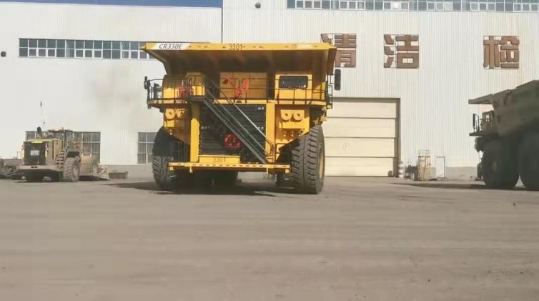
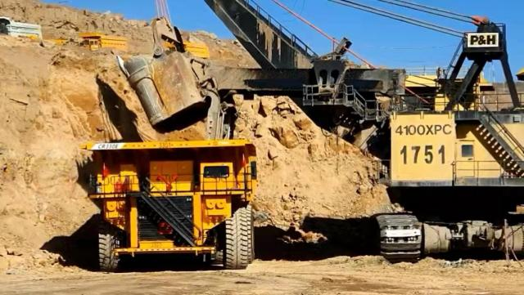
III | Product Itroduction of CRRC Datong
——CR330E Introduction
On September 3rd, 2021, the CR330E mining truck was transported to the East Open-pit Mine site in the form of large parts, and began to assemble and commissioning. On October 18th, the CR330E mining truck successfully completed the assembly and commissioning work. After no-load, half-load and full-load tests, the vehicle successfully completed various tests on October 21st. After being confirmed by the mine party, the CR330E mining truck was incorporated into the mine production fleet and began a one-year industrial test. On October 25th, the vehicle officially entered the "Day and Night" full-load operation mode and is currently operating in good condition. As of May 5th, 2022, the CR330E mining truck has been running at full load for 2,797 hours in the East Open-pit Mine of China Coal Pingshuo Group, with a running mileage of 23,790 kilometers and a transportation volume of about 1,041,466 tons. The dispatch rate is over 93%, and the operation is in good condition.

Slide 18
Content
I
Company Profile
II
R&D Capabilities of Mining Dump Truck
III
Product Introduction of CRRC Datong
IV
Internal Supporting of Core Components
V
Technology under Development
VI
Advantages of CRRC’s Mining Dump Truck

Slide 19
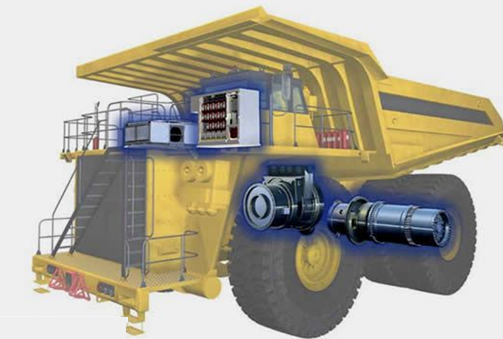
IV| Internal Supporting of Core Components
——Internal Supporting of
Core Components
Based on CRRC's strong R&D and manufacturing advantages, the core components of CRRC Datong's mining dump trucks are independently supplied by CRRC, including main generator, converter cabinet, resistance cabinet, traction motor and wheel reducer.

Slide 20
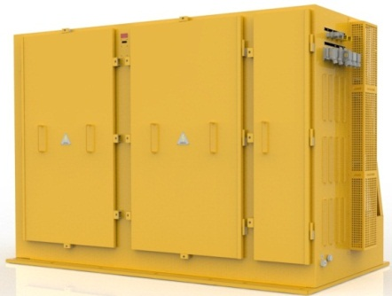
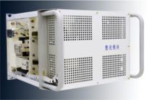

IV| Internal Supporting of Core Components
——Converter Cabinet,
Resistance Cabinet
1. Converter cabinet, resistance cabinet
The equipment provider is CRRC Zhuzhou Institute. The company is the largest system supplier in the field of traction drive and control systems for rail transit equipment in China. It entered the field of converters for mining dump trucks in 2010. Up to now, the power level of its products has covered 540-2600kw, involving different models such as 60-360t.
power module
Over 4200 units
Traction converter
More than 9500 sets

Slide 21
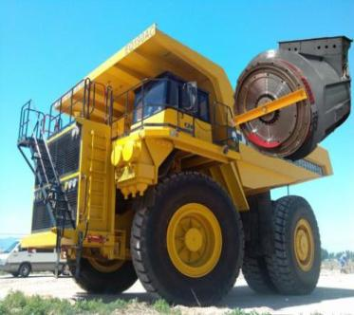
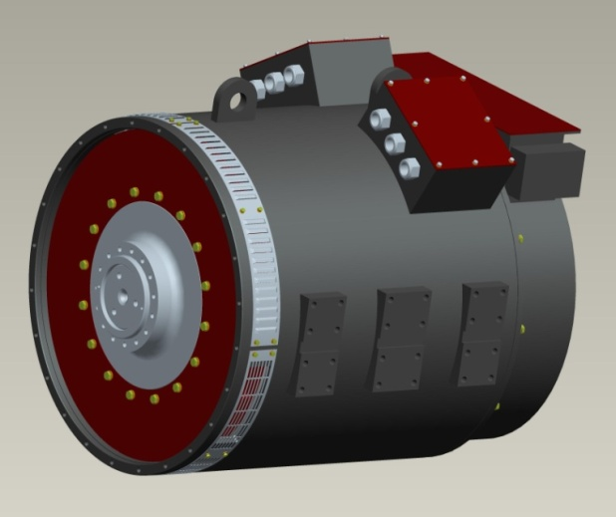
IV| Internal Supporting of Core Components
——Main Generator
2. Main generator
The equipment provider is CRRC Yongji Electric Company. The company is the largest motor supplier for rail transit equipment in China and an important supplier of wind turbines. Electric drive mining dump truck generators have formed 3 series of 14 products, electric motors have formed 4 series of 10 products, and the motor unit products have covered 150t ~ 400t mining dump trucks. Among them, the brushless excitation synchronous main and auxiliary generators have been supplied to Siemens in batches since 2010, and more than 100 units have been installed in the car. Its advanced nature and reliability are at the forefront of products in the same industry in the world.

Slide 22
IV| Internal Supporting of Core Components
——Traction Motor
3. Traction motor
The equipment provider is CRRC Zhuzhou Electric Company. The company is a leading enterprise in China's rail transit and wind power generation parts and equipment. Its motor products are widely used in electric power, metallurgy, chemical industry, petroleum, electric vehicles, coal mines, water affairs, ships and other fields. At present, the cumulative number of electric wheel mining trucks using its motors More than 300 units.

Slide 23
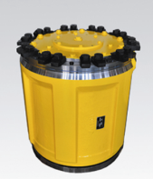
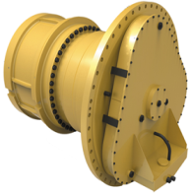
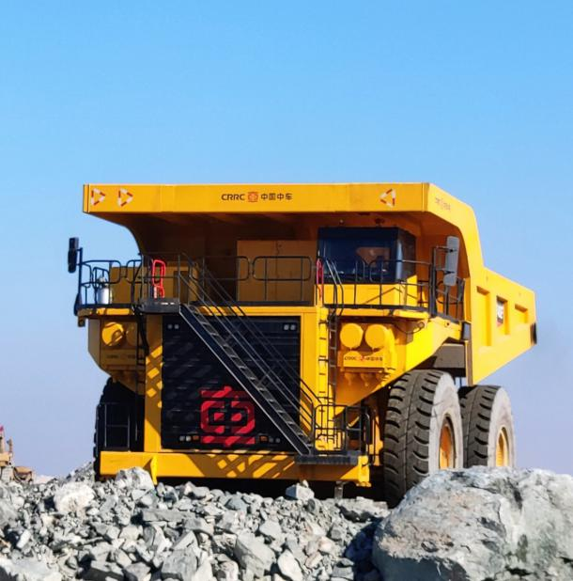

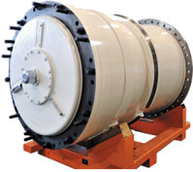
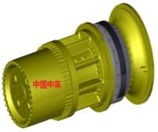
IV| Internal Supporting of Core Components
——Wheel Reducer
4. Wheel reducer
The equipment provider is CRRC Qishuyan Institute. The company is the largest supplier of gear transmission systems for rail transit equipment in China. In 2010, it officially entered the field of wheelside reducers for mining dumpers, providing spare parts for customers in Australia and South America. In 2017, it provided integral electric wheels (wheelside reducer + traction motor).

Slide 24
Content
I
Company Profile
II
R&D Capabilities of Mining Dump Truck
III
Product Introduction of CRRC Datong
IV
Internal Supporting of Core Components
V
Technology under Development
VI
Advantages of CRRC’s Mining Dump Truck

Slide 25
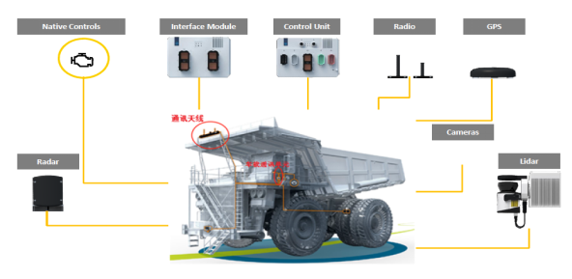
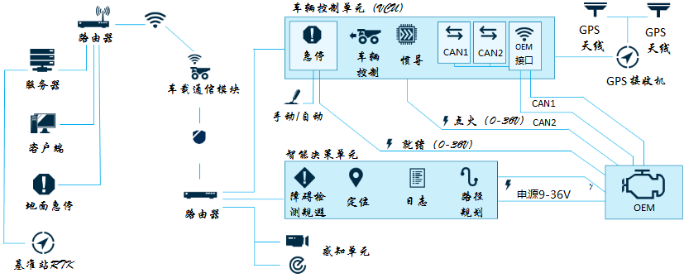
V | Technology under Development
I. Hybrid energy-saving technology
II. Permanent Magnet Drive Technology
The power bidirectional flow electric drive system is adopted, and through the energy management system, the application of technologies such as braking and anti-drag, automatic start and stop, and dual-mode air conditioning can be realized, so that the engine can always work in the most economical state.
It is composed of permanent magnet generator, main and auxiliary integrated converter, and permanent magnet traction motor. It has the advantages of high efficiency, energy saving and high power density, and will become the development direction of the electric drive system of the next generation of mining vehicles.
Permanent Traction Motor
M
M
Engine
G
AC
DC
DC
Current System
Power Bidirectional Flow System
DC
AC
AC
Motor
Permanent Magnet Generator
DC
AC
DC
DC
DC
DC
DC
AC
AC
AC
DC
F
F
F
DC
Brake Resistance
Auxiliary Converter System
III. Dual-mode Driving Technology
IV. Unmanned Driving Technology
Ground Control Center + Vehicle-ground Wireless Communication + Vehicle System
Unmanned actuators can be installed, and relevant communication interfaces are reserved to meet the wire control requirements of unmanned driving. The vehicle has both driverless and manned functions.

Slide 26
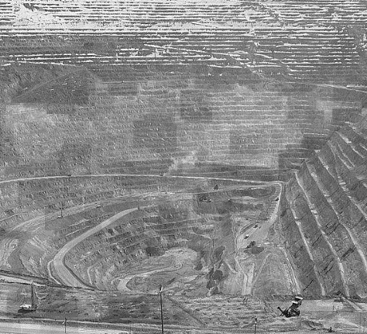




V | Technology under Development
V. Smarted Mines
Provide a complete solution for building a smart mine
Vehicle-to-ground Wireless
Communication System
wireless communication system
RTK GPS Differential Services
Roadside Perception Monitoring
In-vehicle autopilot system
Cooperative Scheduling Control
Status Real-time Monitoring
Data Store Management
Abnormal Situation Handling & Manual Intervention
Remote Control
WIFI--LTE多模通信
Environmental Awareness
Vehicle Control
Digital Mine Management System
Decision-making
Data Logging and
Fault Self-diagnosis

Slide 27
Content
I
Company Profile
II
R&D Capabilities of Mining Dump Truck
III
Product Introduction of CRRC Datong
IV
Internal Supporting of Core Components
V
Technology under Development
VI
Advantages of CRRC’s Mining Dump Truck

Slide 28




VI | Advantages of CRRC’s Mining Dump Truck
Efficient R&D
Cost Controllable
Foundation - Mining vehicle integration technology;
Experience - CRRC R&D platform, shared technology, collaborative design and product integration verification methods;
Strength——Transplantation of track equipment technology to ensure the advanced nature and reliability of the whole vehicle
High degree of support - internal integration of the CRRC system;
Make full use - existing resources of rail transit;
Optimal control - the cost of the whole vehicle and core components;
Price competition - relatively reasonable, obvious advantages.
Production Collaboration
Integrated services
Flexible production—co-production of mining vehicles and rail equipment;
Industrial supporting - a complete supporting industrial chain inside CRRC;
Quality assurance - CRRC integrated quality control system;
High-quality products - collaborative, efficient and controllable production.
Service guarantee - CRRC integrated customer service system;
Service model - provide a full range of butler services;
Service concept - full life cycle cost forecast and control;
Service goal - to provide the best operational service plan.

Slide 29
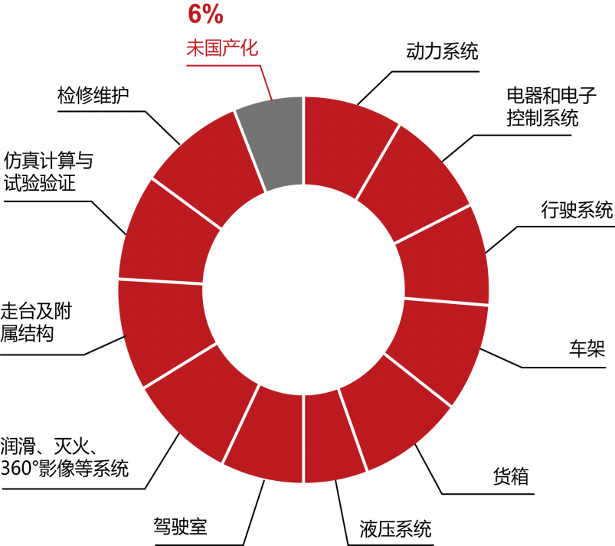

VI | Advantages of CRRC’s Mining Dump Truck
The localization rate reaches 94%
Internal supporting rate reached 83.5%
Power system
Not localized
Power system
No supporting
Electrical and Electronic
Control Systems
Maintenance
Electrical and Electronic
Control Systems
Simulation calculation and
test verification
Maintenance
Travel system
Travel system
Walking table and
auxiliary structure
Simulation calculation and
test verification
Car frame
Car frame
Walking table and
auxiliary structure
Container
Lubrication, fire extinguishing
and 360° video systems
Container
Hydraulic system
Lubrication, fire extinguishing
and 360° video systems
Driver’s cab
Driver’s cab
Hydraulic system
Chinese Mining Trucks are Made by CRRC

Slide 30

Thank you very much!
CRRC DATONG CO., LTD.

